Slide 1
Project Design Thinking
By Group 1: 1. Muhammad Syafiq Bin Abd Razak SX240659ECJHS04
2. Muhammad Syazwan bin Kamaruzaman SX240290ECRHS04
3. Saeed Bin AbdulRahman Saeed Basalama SX230800ECJHS04

Slide 2
Table of contents
01
02
04
05
Objective
03
Problem Statement
Project Scope
06
Design Approach
Mock-up Screens
Presentation Plan

Slide 3
01
Objective

Slide 4
1. Design Mock-up
Done through Photoshop to visualize system’s structure, layout and features
2. Present to Client
Present the mock-up to the client to help visualize the final outcome
3. Receive Feedback
Present the mock-up to the client to help visualize the final outcome

Slide 5
02
Problem Statement

Slide 6
Risk of Data Loss
Physical document can be misplaced or damaged
Ineffiency
Time consuming and human-reliant
Limited Accessablitiy
Physical record restrict access to authorized personal only when on site.

Slide 7
03
Project Scope

Slide 8
Aiding Admin and Management
Student Registration
Dashboard Overview
Student Records
Allows for easy data entry and recording.
Provide a comprehensive view of registered students
Enable efficient records modification

Slide 9
04
Design Approach

Slide 10
UI UX with Photoshop
Design heavily prioretises user experience by considering a responsive design, simple navigation and visual consistency

Slide 11
05
Mock-up Screens
You can enter a subtitle here if you need it

Slide 12
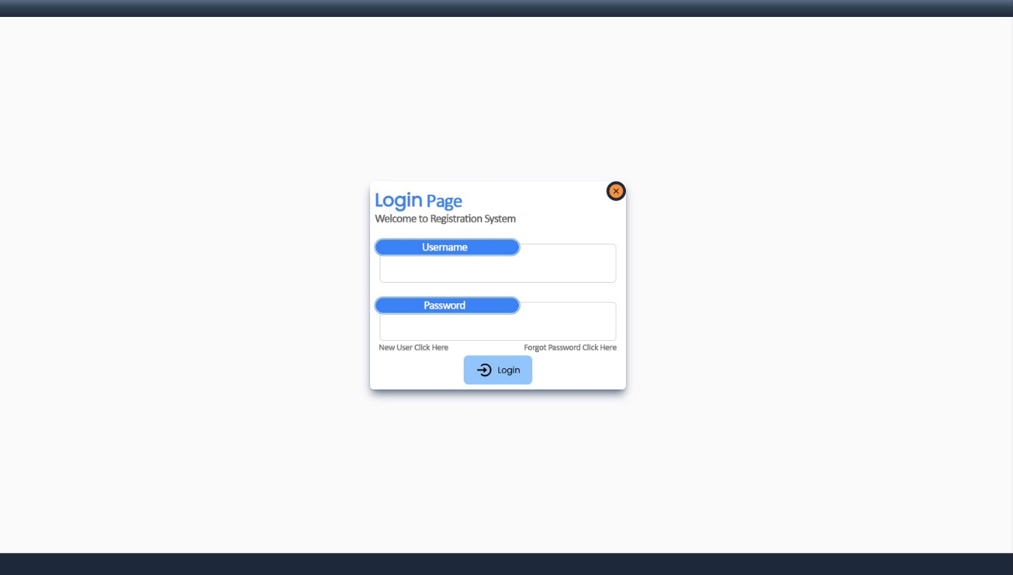
Login Page

Slide 13
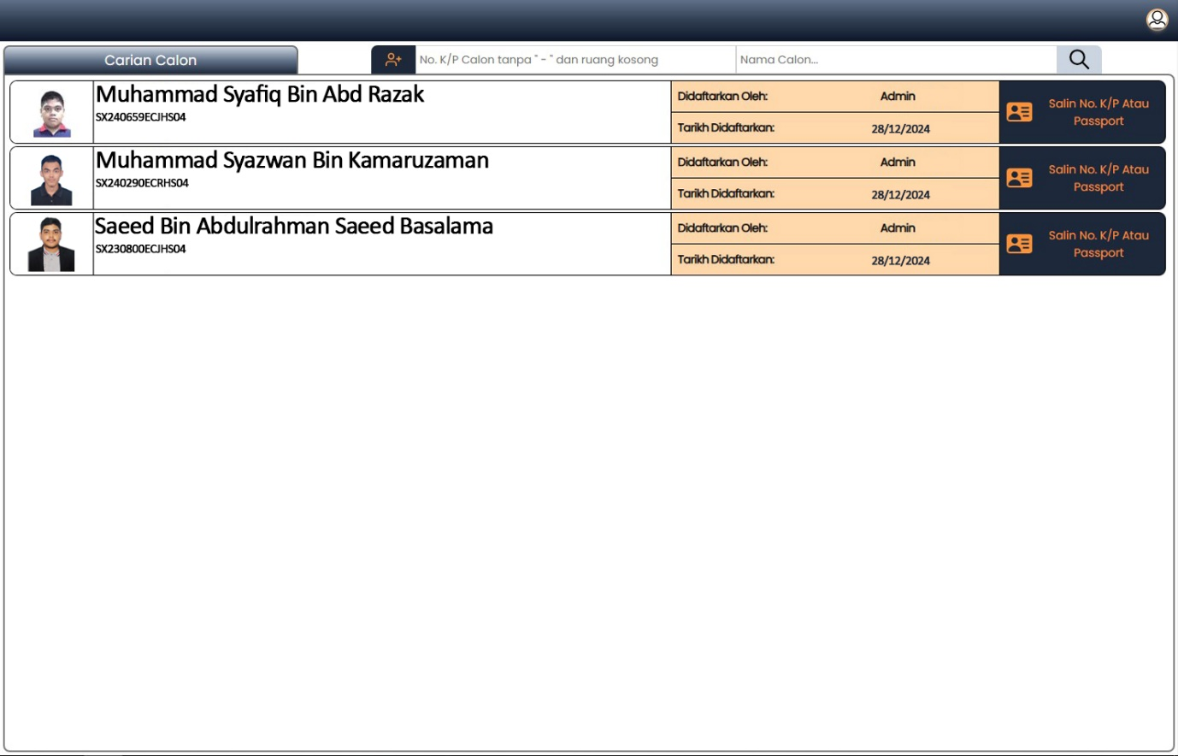
Landing Page

Slide 14
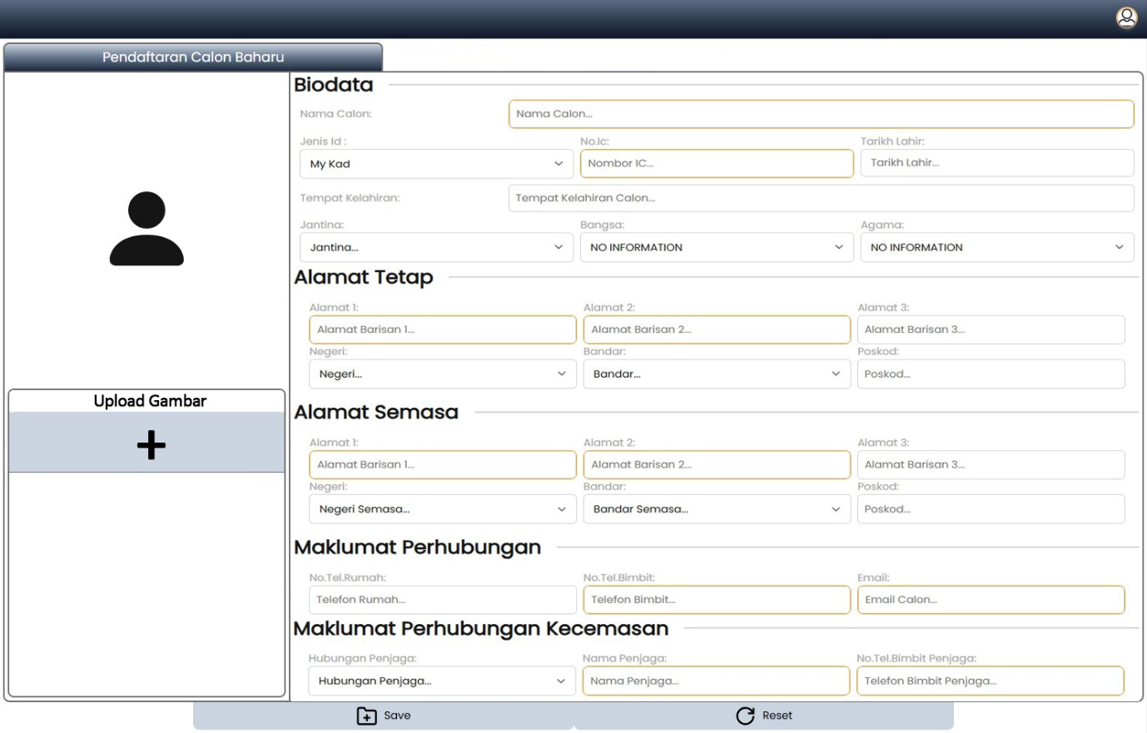
Student Registration Page

Slide 15
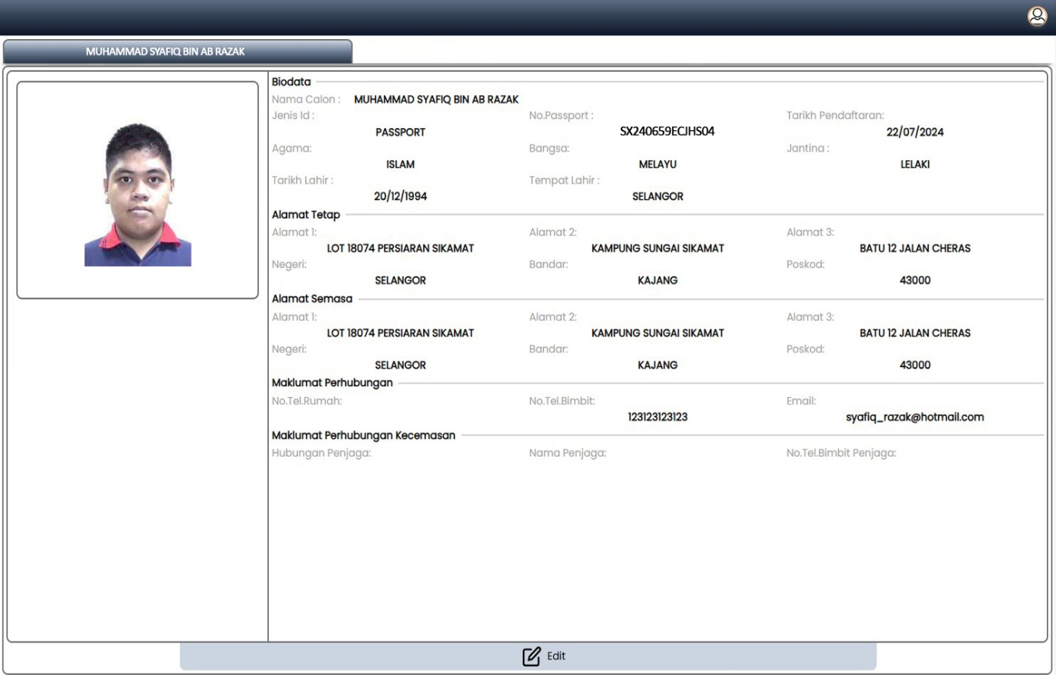
Student Record Management

Slide 16
06
Presentation Plan

Slide 17
Client Feedback Expectation
Review of the client
Each screen will be explained in detail by highlighting key features and functionalities and receive the client feedback accordingly
Expected Outcome
Provide a clear path for the development team
Identify early potential design flaw

Slide 18

Questions?

Slide 19
Thank You!

